Slide 1
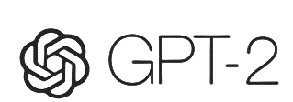


ANALYTICS 4
Text Summarization
using GPT2
Bharath Kumar Nanda Kumar
11014144
01

Slide 2

Index
Use Case – Text Summarization
Brief, Need, Type
Architecture Explained – GPT 2
Overview, Background, Terminologies
Working of the architecture – GPT 2
Genesis, Process
Model Description – GPT2
python package, model used
Evaluation with other architecture
Functionality, Comparison
02

Slide 3
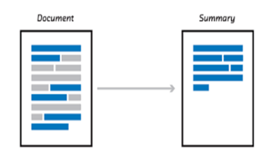
Use Case - Text Summarization
Brief:
A process of creating a short, coherent, and fluent summary of a longer text document and involves the outlining of the text’s major points
The technique that shortens a long piece of content with main points outlined that gives an idea of the whole content
Natural language processing aka NLP ( the branch of artificial intelligence or AI—concerned with giving computers the ability to understand text and spoken words in much the same way human beings can) used in Text Summarization
Need:
Saves Time - By generating automatic summaries, text summarization helps content editors save time and effort
Instant Response - It reduces the user’s effort involved in exacting the relevant information
Increases Productivity Level – It enables the user to scan through the contents of a text for accurate, brief, and precise information
Ensures All Important Facts are Covered - The human eye can miss crucial details; however, automatic software does not
03

Slide 4
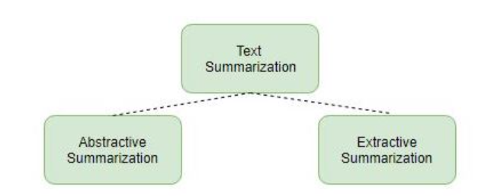
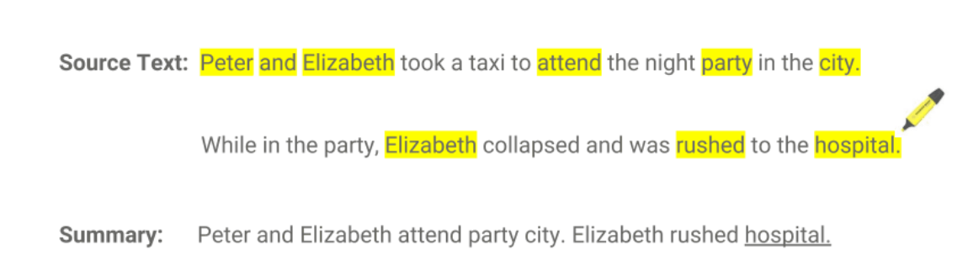
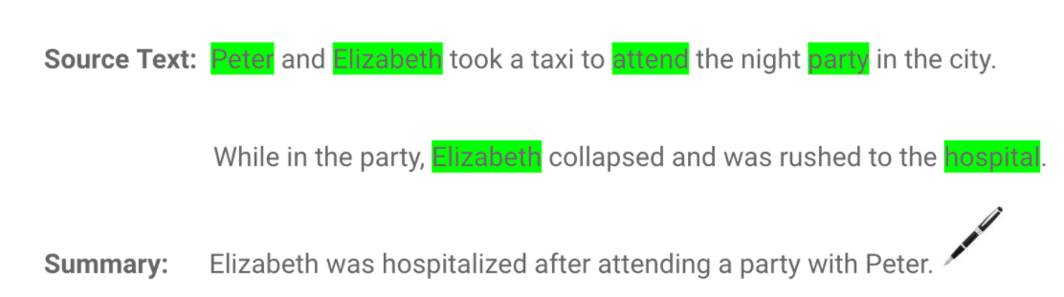
Use Case - Text Summarization
Type:
Extractive Summarization - This approach selects the main passages to create a summary. It will weight the important part of documents and rank them based on importance and similarity among each other. This technique involves pulling key phrases from the source document and combining them to make a summary.
Abstractive Summarization – This select words based on semantic understanding, even those words did not appear in the source documents. It avoids the grammar inconsistencies that usually happens in extraction- based text summarization.
04

Slide 5
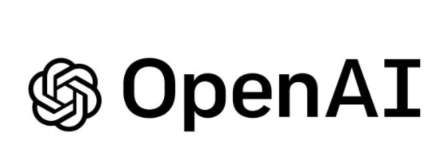
Architecture used – GPT2
Overview:
Generative Pre-trained Transformer 2 (GPT-2) is an open-source artificial intelligence created by OpenAI in February 2019
It translates text, answers questions, summarizes passages, and generates text output on a level which is indistinguishable from humans and can become repetitive when generating long passage
Language tasks such as reading, summarizing and translation can be learned by GPT-2 from raw text without using domain specific training data
Background:
GPT2 is one from the series of Generative Pre-trained Model (GPT)
GPT is one of the pioneers in Language Understanding and Modeling i.e., the use of various statistical and probabilistic techniques to determine the probability of a given sequence of words occurring in a sentence used in Natural Language Processing application ( giving computers the ability to understand text and spoken words in much the same way human beings can)
It essentially proposes the concept of pre-training ( old knowledge helps new models successfully perform new tasks from old experience instead of from scratch) a language model on a huge corpus of data and then fine-tuning ( a model that has already been trained for a particular task and then fine-tuning or tweaking it to make it perform a second similar task)
05

Slide 6
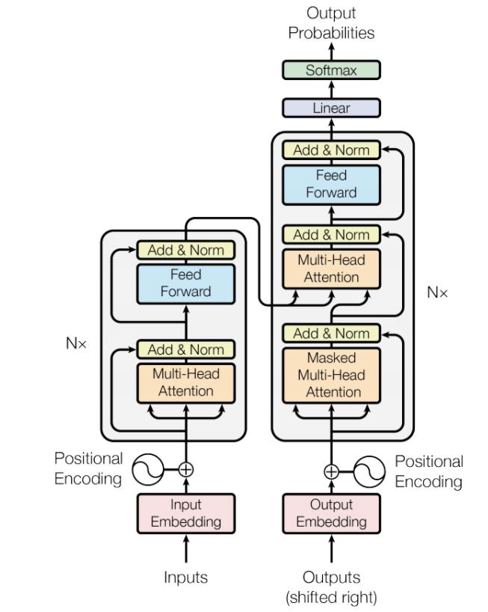
Architecture used – GPT2
Terminologies in GPT architecture
As mentioned in the OpenAI blog – “first we train a transformer model on a very large amount of data in an unsupervised manner — using language modeling as a training signal — then we fine-tune this model on much smaller supervised datasets to help it solve specific tasks”
Supervised learning uses labeled input and output data and algorithm “learns” from the training dataset by iteratively making predictions on the data and adjusting for the correct answer
An Unsupervised learning algorithm uses unlabeled data. It discovers hidden patterns or data groupings without the need for human intervention.
Transformers are semi-supervised machine learning models that are primarily used with text data. They are designed to work on sequence data and will take an input sequence and use it to generate an output sequence one element at a time.
Transformers use an attention mechanism called self-attention. The idea is that by using a function (the scaled dot product attention), we can learn a vector of context, meaning that we use other words in the sequence to get a better understanding of a specific word.
06

Slide 7
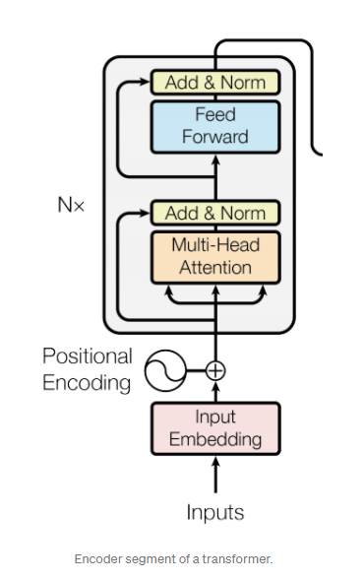
Architecture used – GPT2
Terminologies in GPT architecture
Transformer:
Encoder and Decoder: It has two main segments – encoder (that operates primarily on the input sequence) and the decoder (that operates on the target output sequence during training and predicts the next item in the sequence)
Input and Output Embedding: They are basically just embedding layers. The embedding layer takes a sequence of words and learns a vector representation for each word.
Positional Encoding: This block applies a function to the embedding matrix that allows a neural network to understand the relative position of each word vector even if the matrix was shuffled
Multi-Head Attention: It is the main innovation behind transformers. The question that the attention block aims to answer is what parts of the text should the model focus on? A single attention block can tell a model to pay attention to something specific such as the tense in a sentence.
Add & Norm: This layer simply takes the outputs from the multi-head attention block, adds them together, and normalizes the result with inputs to a layer across all features
Feed-forward layer: This operates on the output attention vectors and learns to recognize patterns within them
Encoder : is the part of the transformer that chooses what parts of the input to focus on. computes the embedding matrix, and then converts it into a series of attention vectors. The multi-head attention block initially produces these attention vectors, which are then added and normalized, passed into a fully-connected layer (Feed Forward in the diagram above), and normalized again before being passed over to the decoder.
07

Slide 8
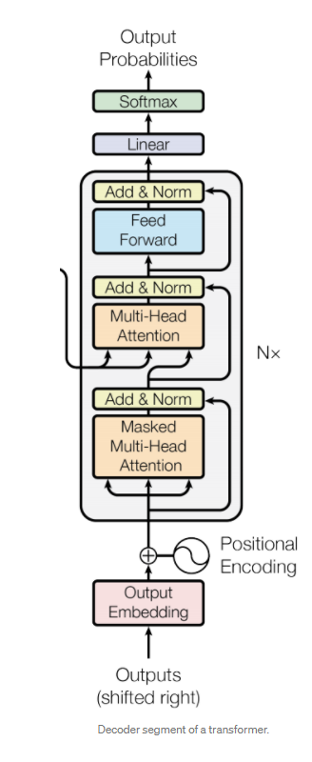
Architecture used – GPT2
Terminologies in GPT architecture
Transformer:
Decoder: During training, the decoder operates directly on the target output sequence . In the decoder, separate embedding vectors are computed for each word in the sentence, and the positional encoding is also applied in the form of sine and cosine functions.
Masked attention block: It is used, meaning that only the previous word in the sentence is used and the other words are masked. This allows the transformer to learn to predict the next word. The outputs of this masked attention block are added and normalized before being passed to another attention block that also receives the attention vectors produced by the encoder.
Feed-forward network: It receives the final attention vectors and uses them to produce a single vector with a dimension equal to the number of unique words in the model’s vocabulary
SoftMax activation function: Applying to this the vector produces a set of probabilities corresponding to each word.
08

Slide 9
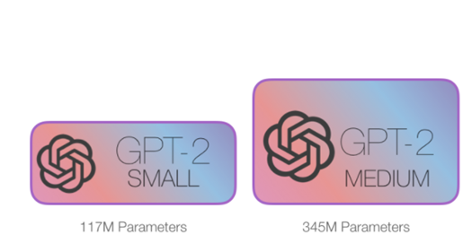
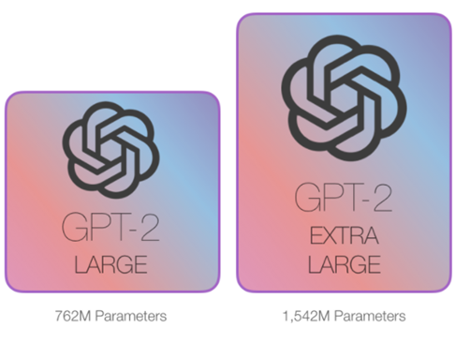
Working Architecture of GPT-2
Genesis of GPT2
An even larger dataset was used along with having a larger corpus of parameters and ability to perform task-based processing for the same input data
The task-specific processing laid the foundations for what is called Zero-shot task transfer. Basically, the model is not fed with any examples and is specified only with a task. The model is required to perceive the sentiment of the task and shower the answers.
It was developed using a mammoth 40GB of internet text data from over 8 million web pages
The Model Architecture of GPT2 has 1.5 Billion Parameters (properties of training data that will learn during the learning process and measure of how well a model is performing). It also consist of word embedding the model had 48 layers and 1600 dimensional vectors
The model was presented with a varying number of parameters: 117 million, 345 million, 762 million and 1542 million
The GPT-2 model consisted of 50,257 tokens to mark a significant scaling of the vocabulary. Moreover, 512 tokens worth the size of batch and an even larger 1024 tokens for the context window were used
09

Slide 10
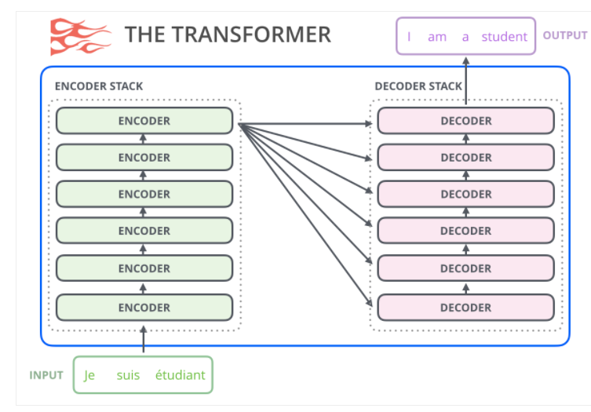
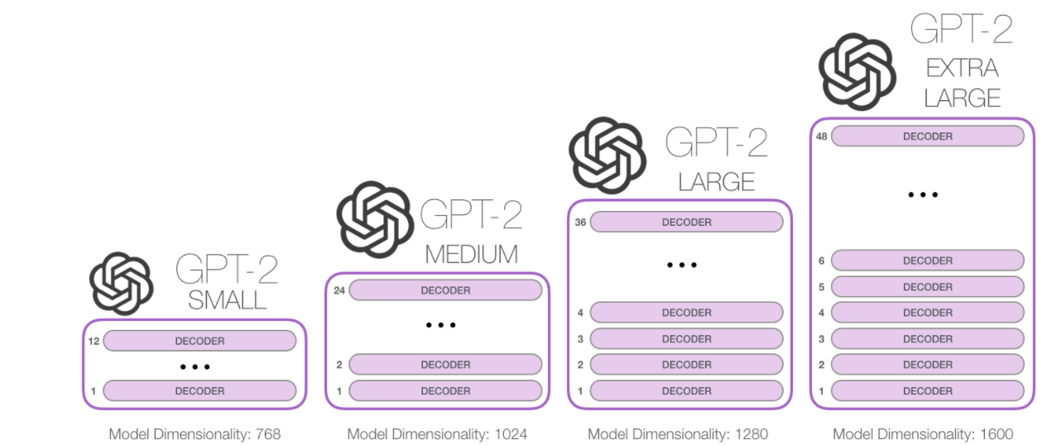
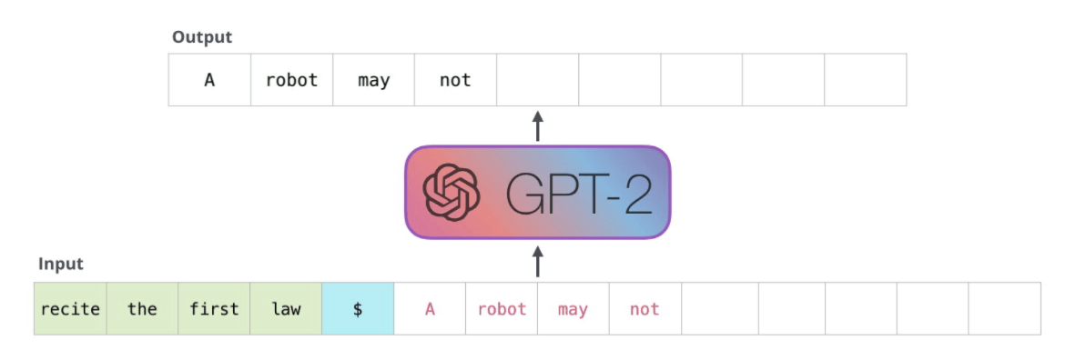
Working Architecture of GPT-2
Process of GPT2
The original transformer model is made up of an encoder and decoder – each is a stack of what we can call transformer blocks
It turns out that’s one of the main distinguishing factors between the different GPT2 model sizes is the stacking of blocks
GPT-2 is built using transformer decoder blocks
The way these models work is that after each token is produced, that token is added to the sequence of inputs. And that new sequence becomes the input to the model in its next step. This is called “auto-regression”
10

Slide 11
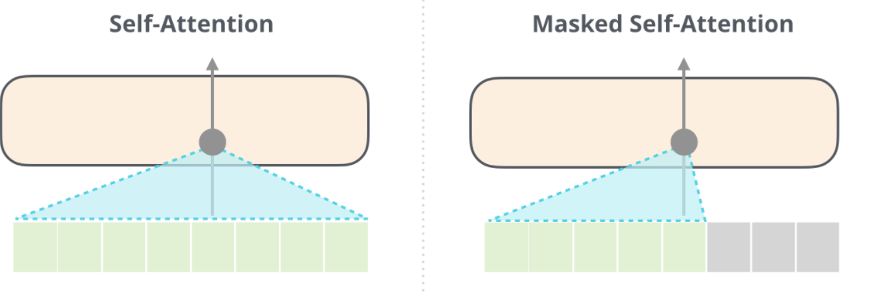
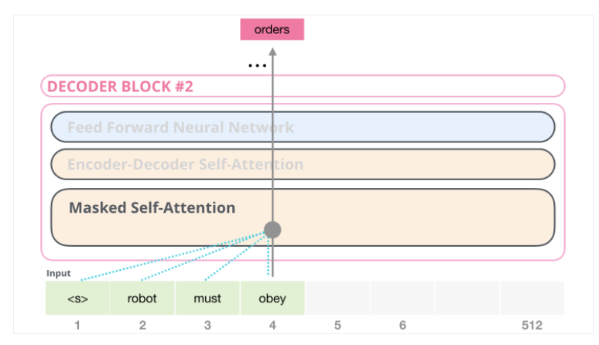
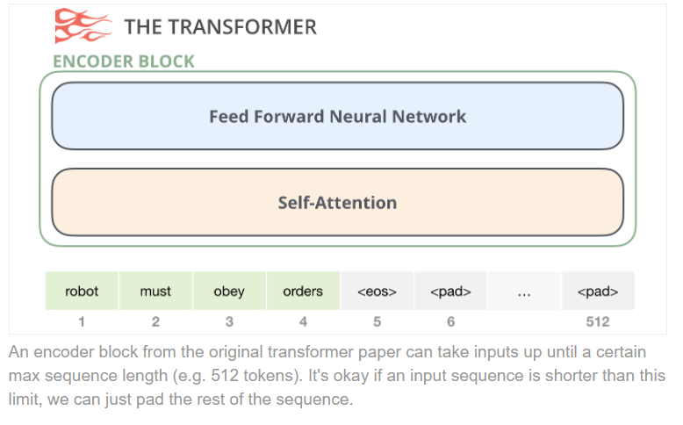
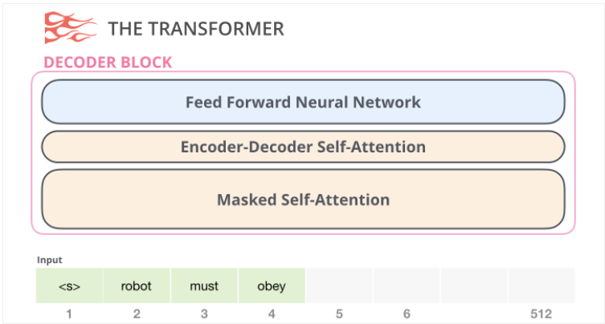
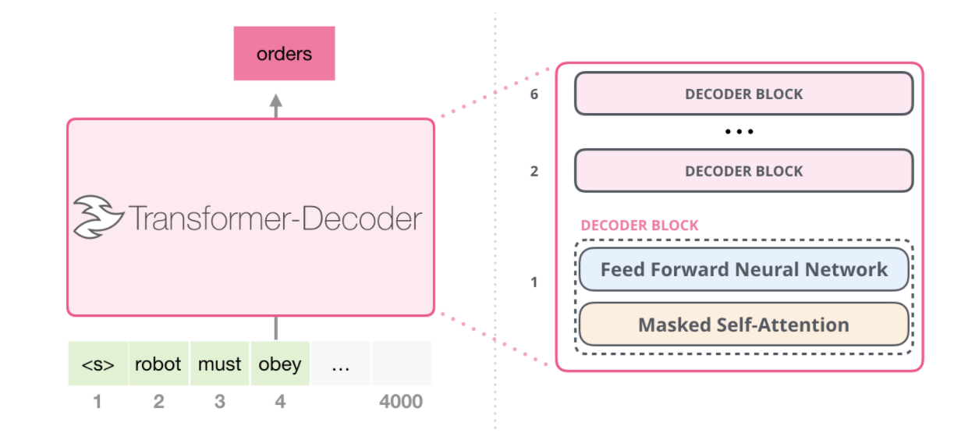
Working Architecture of GPT-2
Process of GPT2
The decoder block which has a small architectural variation from the encoder block – a layer to allow it to pay attention to specific segments from the encoder
In the self-attention layer here, is that it masks future tokens – not by changing the word to [mask], but by interfering in the self-attention
calculation blocking information from tokens that are to the right
of the position being calculated.
For eg, in the figure of Decoder block #2, the path of position #4 it is only allowed to attend to the present and previous tokens
A normal self-attention block allows a position to peak at tokens to its right and masked self-attention prevents that from happening
The early transformer-based language model was made up of a stack of six transformer decoder blocks. These blocks were very similar to the original decoder blocks, except they did away with that second self-attention layer. GPT-2 model uses these decoder-only blocks.
11

Slide 12
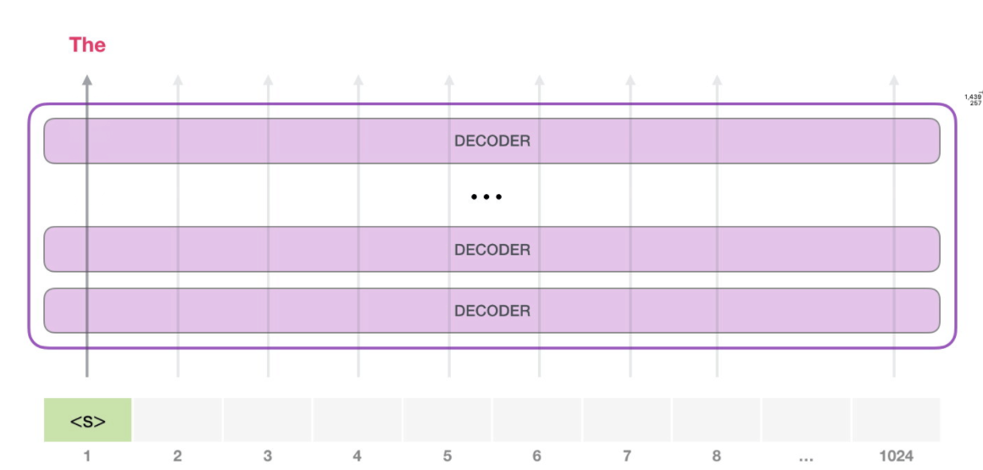
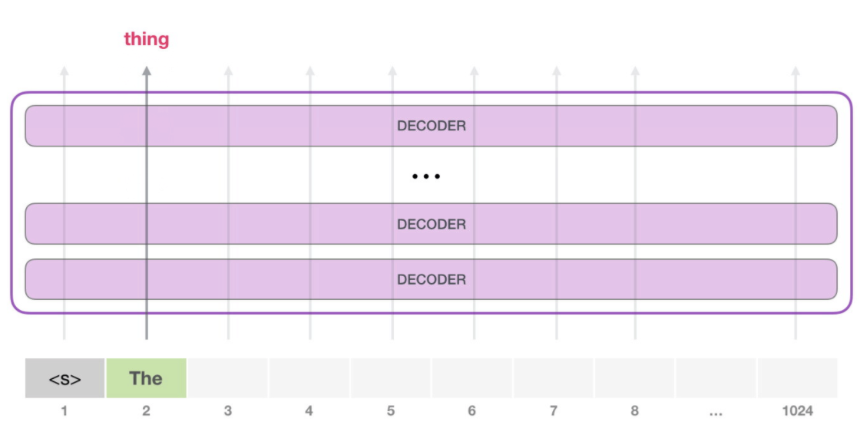
Working Architecture of GPT-2
Process of GPT2
The simplest way to run a trained GPT-2 is to allow it to ramble on its own (which is technically called generating unconditional samples)
In the rambling case, we can simply hand it the start token. the trained model uses <|endoftext|> as its start token. Let’s call it <s> instead)
The model only has one input token, so that path would be the only active one. The token is processed successively through all the layers, then a vector is produced along that path. That vector can be scored against the model’s vocabulary (all the words the model knows, 50,000 words in the case of GPT-2). In this case we selected the token with the highest probability, ‘the’.
GPT-2 has a parameter called top-k that we can use to have the model consider sampling words other than the top word (which is the case when top-k = 1)
In the next step, we add the output from the first step to our input sequence, and have the model make its next prediction
Notice that the second path is the only that’s active in this calculation. Each layer of GPT-2 has retained its own interpretation of the first token and will use it in processing the second token
It does not re-interpret the first token considering the second token
12

Slide 13
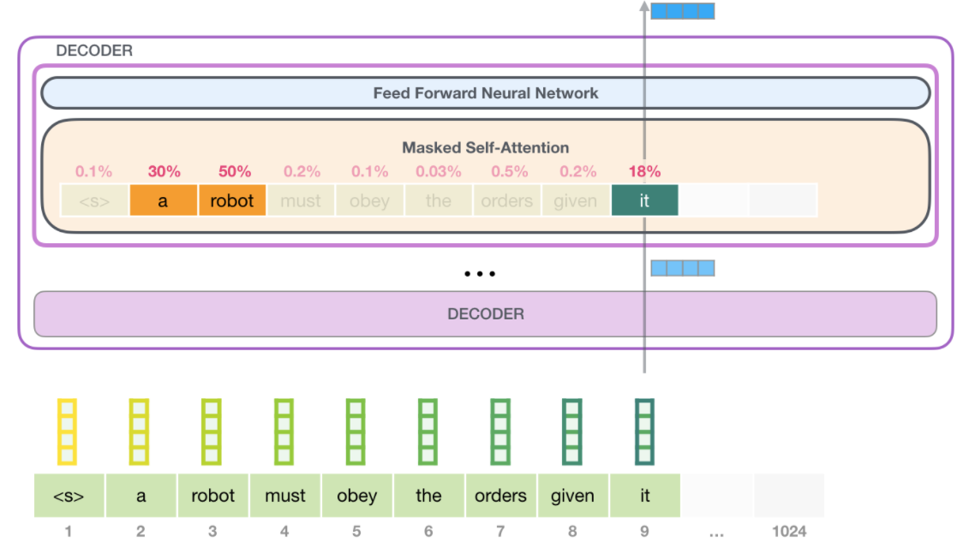
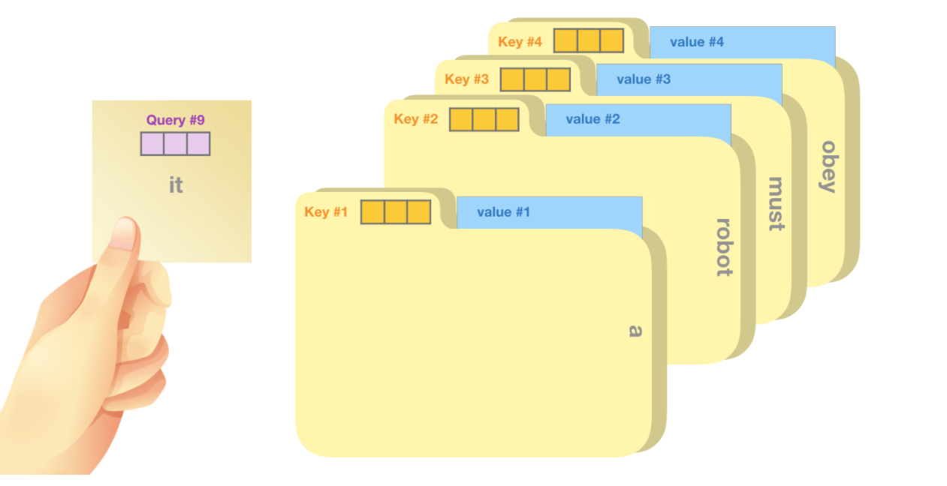
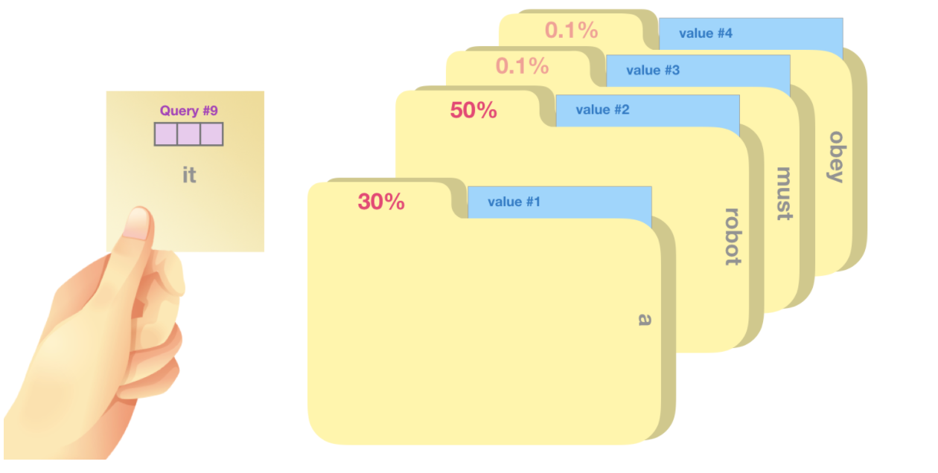
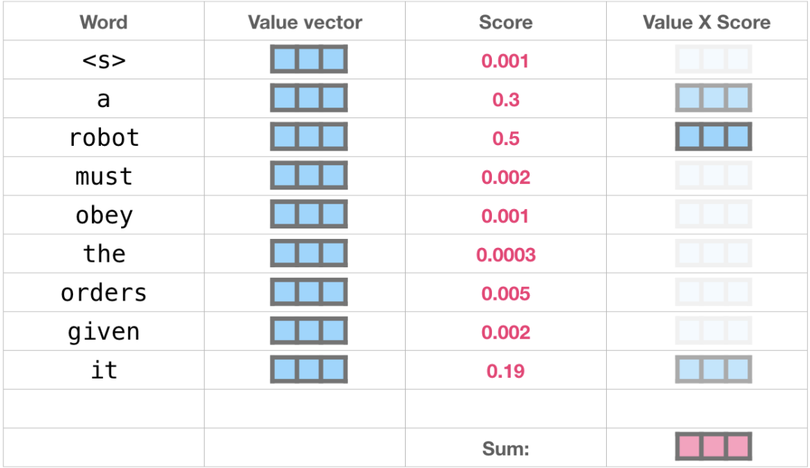
Working Architecture of GPT-2
Self Attentive Process of GPT2
Self-attention is processed along the path of each token in the segment. The significant components are three vectors:
Query: The query is a representation of the current word used to score against all the other words (using their keys). We only care about the query of the token we’re currently processing.
Key: Key vectors are like labels for all the words in the segment. They’re what we match against in our search for relevant words.
Value: Value vectors are actual word representations, once we’ve scored how relevant each word is, these are the values we add up to represent the current word.
The query is like a sticky note with the topic you’re researching. The keys are like the labels of the folders inside the cabinet. When you match the tag with a sticky note, we take out the contents of that folder, these contents are the value vector. Except you’re not only looking for one value, but a blend of values from a blend of folders.
Multiplying the query vector by each key vector produces a score for each folder (technically: dot product followed by softmax).
We multiply each value by its score and sum up – resulting in our self-attention outcome.
This weighted blend of value vectors results in a vector that paid 50% of its “attention” to the word robot, 30% to the word a, and 19% to the word it
13

Slide 14
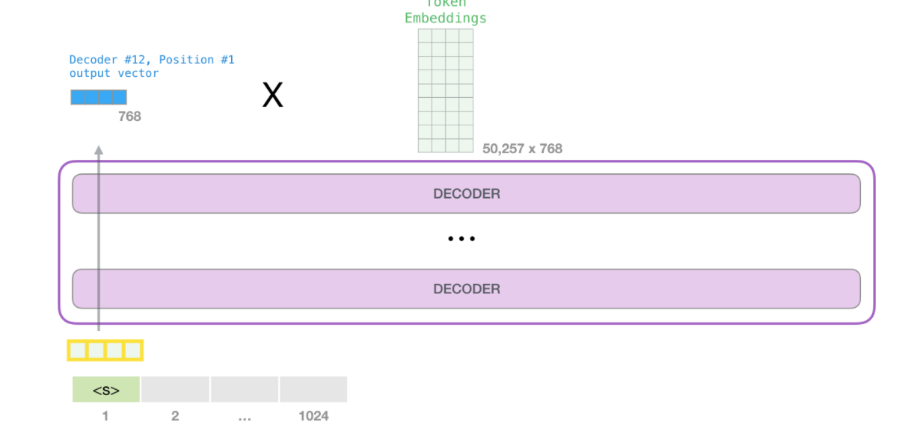
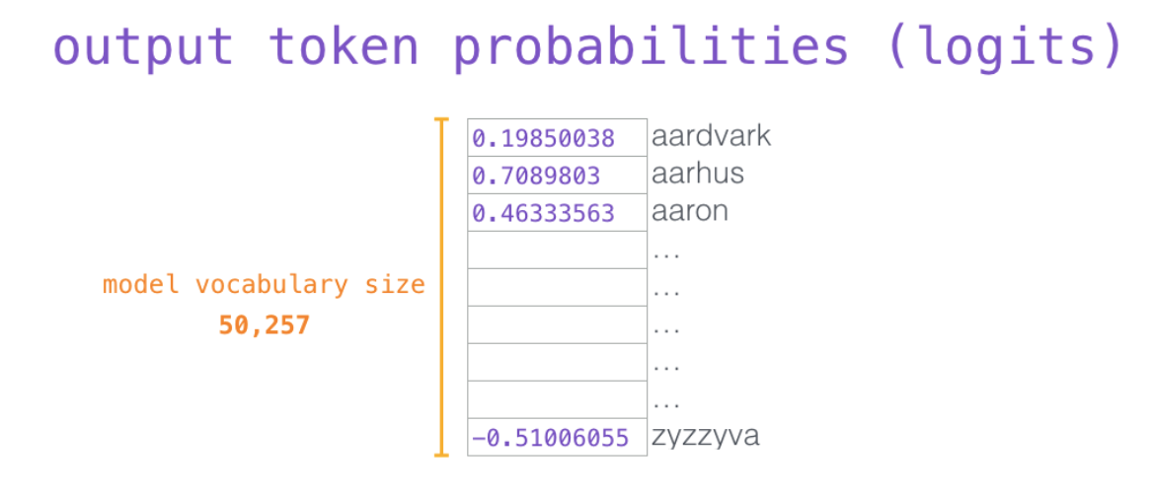
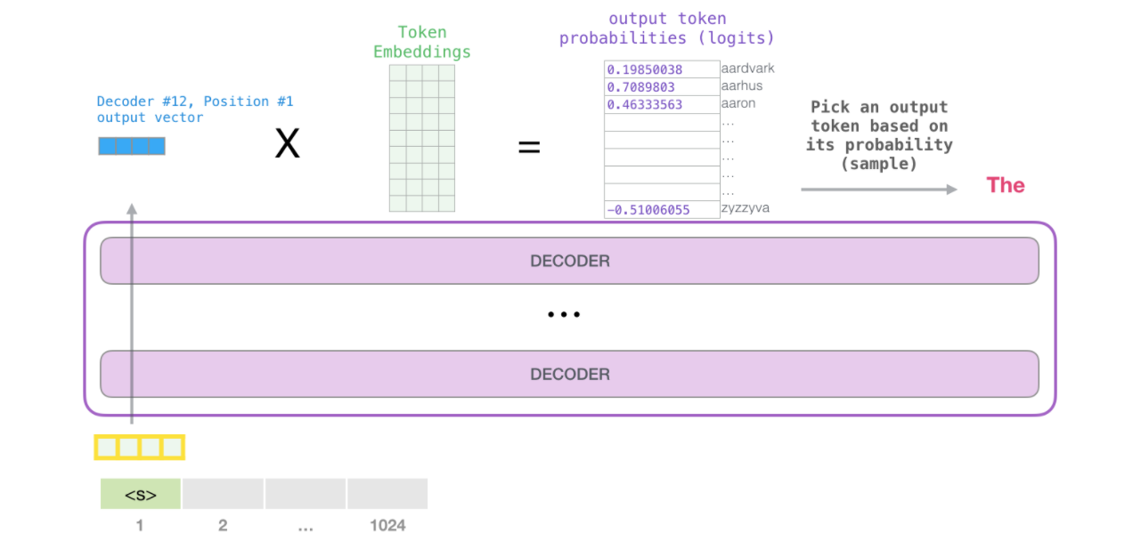
Working Architecture of GPT-2
Model Output of GPT2
When the top block in the model produces its output vector (the result of its own self-attention followed by its own neural network), the model multiplies that vector by the embedding matrix.#
Recall that each row in the embedding matrix corresponds to the embedding of a word in the model’s vocabulary. The result of this multiplication is interpreted as a score for each word in the model’s vocabulary.
We can simply select the token with the highest score (top_k = 1). But better results are achieved if the model considers other words as well. So a better strategy is to sample a word from the entire list using the score as the probability of selecting that word (so words with a higher score have a higher chance of being selected). A middle ground is setting top_k to 40, and having the model consider the 40 words with the highest scores.
With that, the model has completed an iteration resulting in outputting a single word. The model continues iterating until the entire context is generated (1024 tokens) or until an end-of-sequence token is produced.
14

Slide 15
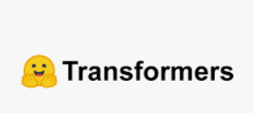
Model Description GPT-2
Using ‘Transformers’ package imported ‘GPT2LMHeadModel, GPT2Tokenizer’ for GPT2
GPT2 Tokenizer
Construct a GPT-2 tokenizer. Based on byte-level Byte-Pair-Encoding.
This tokenizer has been trained to treat spaces like parts of the tokens (a bit like sentencepiece) so a word will be encoded differently whether it is at the beginning of the sentence (without space) or not
GPT2LMHeadModel
The GPT2 Model transformer with a language modeling head on top (linear layer with weights tied to the input embeddings).
15

Slide 16
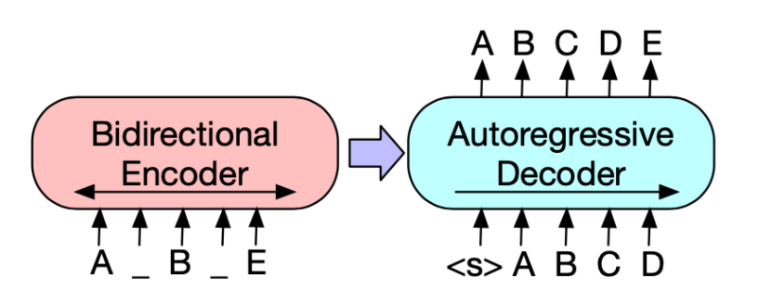
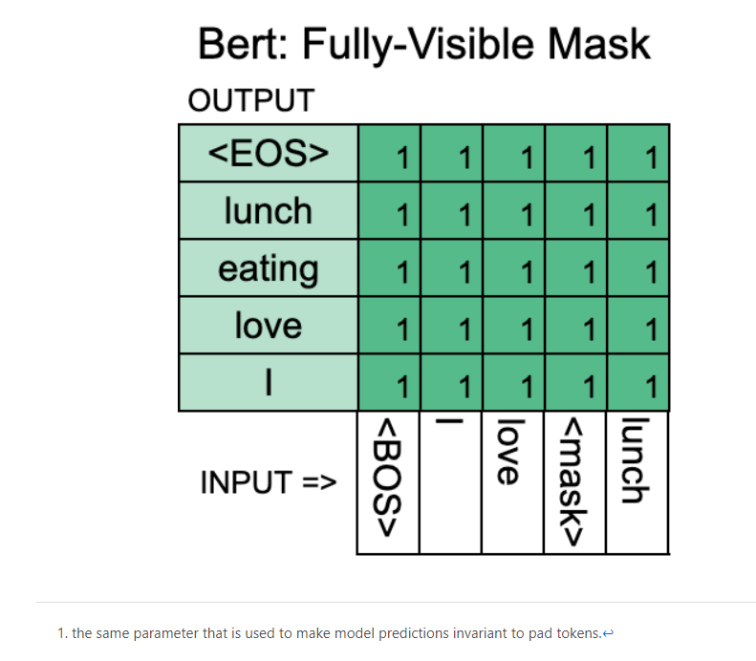
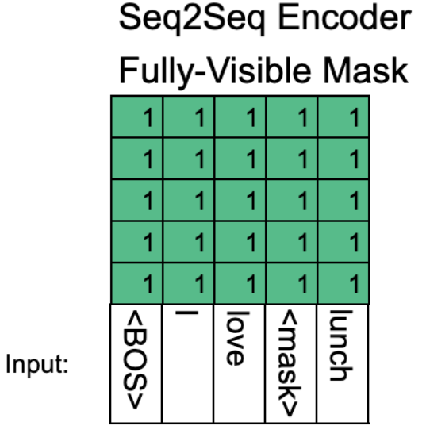
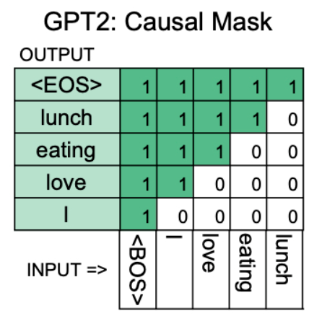
Evaluation with other architecture
Bidirectional and Auto-Regressive Transformer or BART is a Transformer that combines the Bidirectional Encoder (i.e. BERT like) with an Autoregressive decoder (i.e. GPT like) into one Seq2Seq model.
16

Slide 17
THANK YOU

